Slide 1
RNA-seq part II: quantification and models for assessing differential expression (at least for some approaches)
Ian Dworkin
NGS 2015

Slide 2
Analysis for DE using RNAseq is getting much faster.

Slide 3
What we will cover today
Why we use count data as input
Introducing a bit of probability to why many RNA Differential analysis tools use a negative binomial.
Why do care about variance/over-dispersion so much.
How do we estimate over-dispersion with small sample sizes (and why edgeR and DGE give different results).

Slide 4
Counting
One of the most difficult issues has been how to count reads.

Slide 5
Counting
We are interested in transcript abundance.
But we need to take into account a number of things.
How many reads in the sample.
Length of transcripts
GC content and sequencing bias (influencing counts of transcripts within a sample).

Slide 6
Seemingly sensible Counting (but ultimately not so useful).
RPKM (reads aligned per kilobase of exon per million reads mapped) – Mortazavi et al 2008
FPKM (fragments per kilobase of exon per million fragments mapped). Same idea for paired end sequencing.
TPM, TMM… etc…

Slide 7
Take home message (from me): Actual counts should be used as input for differential expression analysis, not (pre)scaled measures.

Slide 8
Take home message: BUT: Not everyone agrees with this approach though. Nor with my arguments about counting. Lior Patcher’s blog is a good place to watch the debate. Also check out some comments in the vignette and paper on limma/voom.

Slide 9
RPKM

Slide 10
Problems with RPKM
RPKM is not a consistent measure of expression abundance (or relative molar concentration).
See
http://blog.nextgenetics.net/?e=51
Wagner et al 2012 Measurement of mRNA abundance using RNA-seq data: RPKM measure is inconsistent among samples. Theory Biosci

Slide 11
How about Transcripts per million (TPM)
While TPM is in general more (statistically) consistent, it is still generally not appropriate.

Slide 12
Normalization (for DE) can be much more complicated in practice
Why might scaling by total number of reads (sequencing depth) be a misleading quantity to scale by?

Slide 13
Normalization (for DE) can be much more complicated in practice
Scaling by total mapped reads (sequencing depth) can be substantially influenced by the small proportion of highly expressed genes.
(What might happen?)
A number of alternatives have been proposed and used (i.e. using quantile normalization, etc..)
Bullard, J. H., Purdom, E., Hansen, K. D., & Dudoit, S. (2010). Evaluation of statistical methods for normalization and differential expression in mRNA-Seq experiments. BMC Bioinformatics, 11, 94. doi:10.1186/1471-2105-11-94

Slide 14
Counting (and normalizing) in practice
In practice, we do not want to “pre-scale” our data as is done in F/R-PKM or TPM.
Instead we are far better off using a model based approach for normalizing for read-length or library size in the data modeling per se.
This is far more flexible.

Slide 15
Take home message: Actual counts should be used as input for differential expression analysis, not (pre)scaled measures.

Slide 16
Counting fragments to genes, transcripts, exons, kmers..
I have been discussing this from a perspective of counting reads to features such as genes or transcripts.
Cogent arguments are made to instead use using exons, or even individual nucleotides within exons (Lauren McIntyre).
Recently a number of approaches of counting kmers has become prevalent. These are much faster!

Slide 17
Analysis for DE using RNAseq is getting much faster.

Slide 18
Using kmers as features for counting
Several tools:
Sailfish
RNA-skim
kallisto (with sleuth, released yesterday)
There is a lot of “buzz” about such approaches, and may be worth trying, but they are still being evaluated by many groups.
Matt and I may try to put something together.

Slide 20
A bit of background on probability.
Fundamentally our observed measure of expression are the counts of reads.
Depending upon the data modeling framework we wish to use, we need to account for this, as these are not necessarily approximated well by normal (Gaussian) distributions that are used for “standard” linear models like t-tests, ANOVA, regression.
This is not a problem at all, as it is easy to model data coming from other distributions, and is widely available in stats packages and programming languages alike.

Slide 21
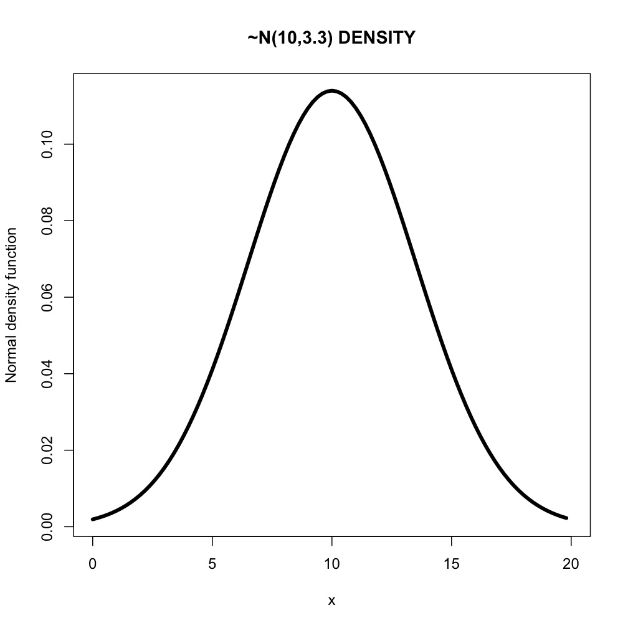
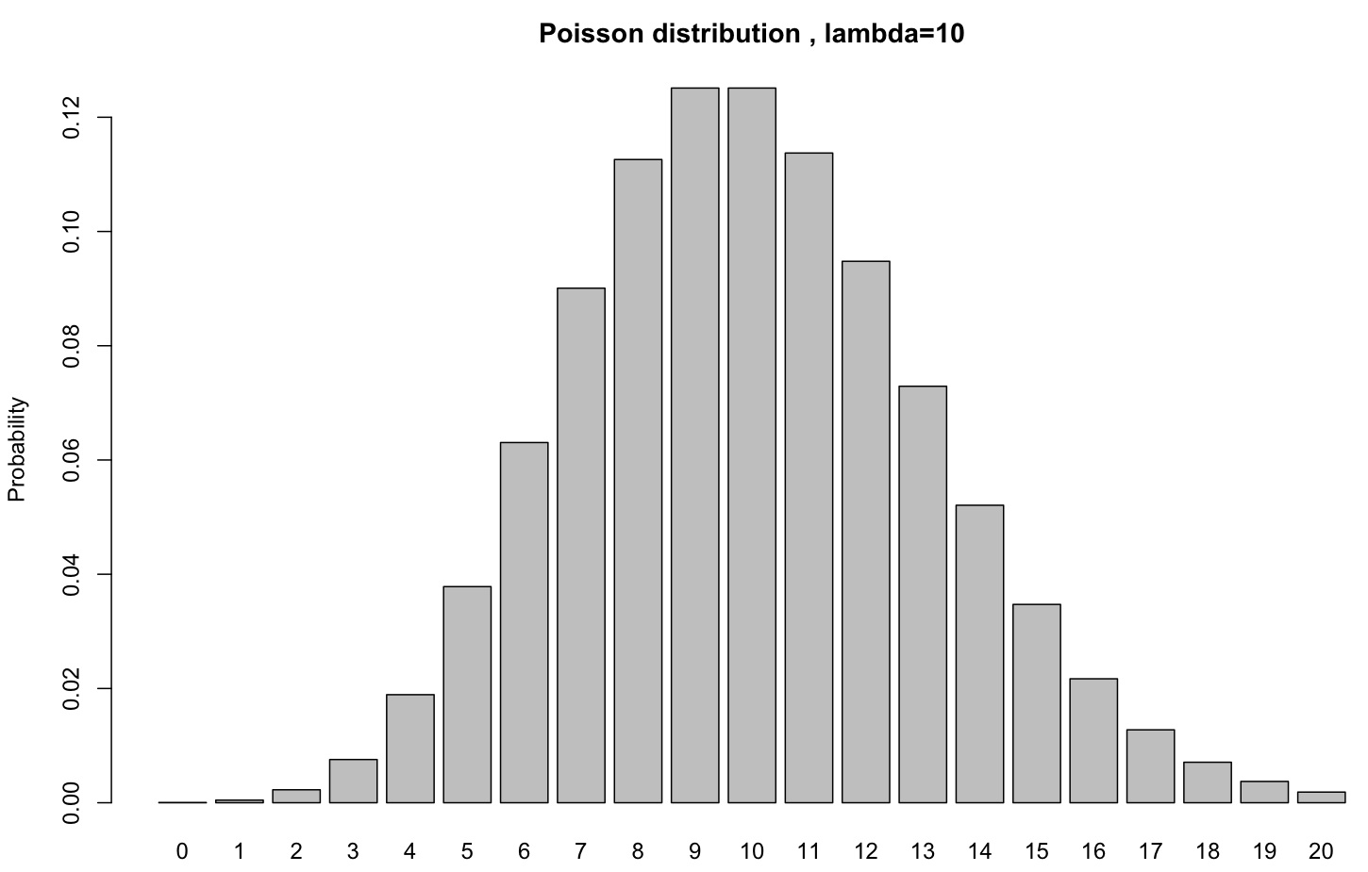
Probability Density vs. Mass function
Probability Mass function for a discrete variable.
Probability Density function for a continuous variable.

Slide 22
Probability Mass function (For discrete distributions, like read counts)
P(13| Poisson (λ=10)) =0.073
Height represents the probability at that point (integer).
“Area” of the box has no particular meaning.
P(integer) ≥ 0
P(non-integers) = 0.

Slide 23
Probability Density function
Height at x= 13 is 0.0799
This is not the probability at x=13, but the density.
i.e. f(13) = 0.0799, where f(x) is the normal distribution.
P(x=13| N(mean=10,sd=3.3)) = 0
WHY?

Slide 24
Probability Density function
We can define the probability in the interval
10 ≤ x ≤ 15
P(10 ≤ x ≤ 15| N(10,3.3)) =0.435

Slide 25
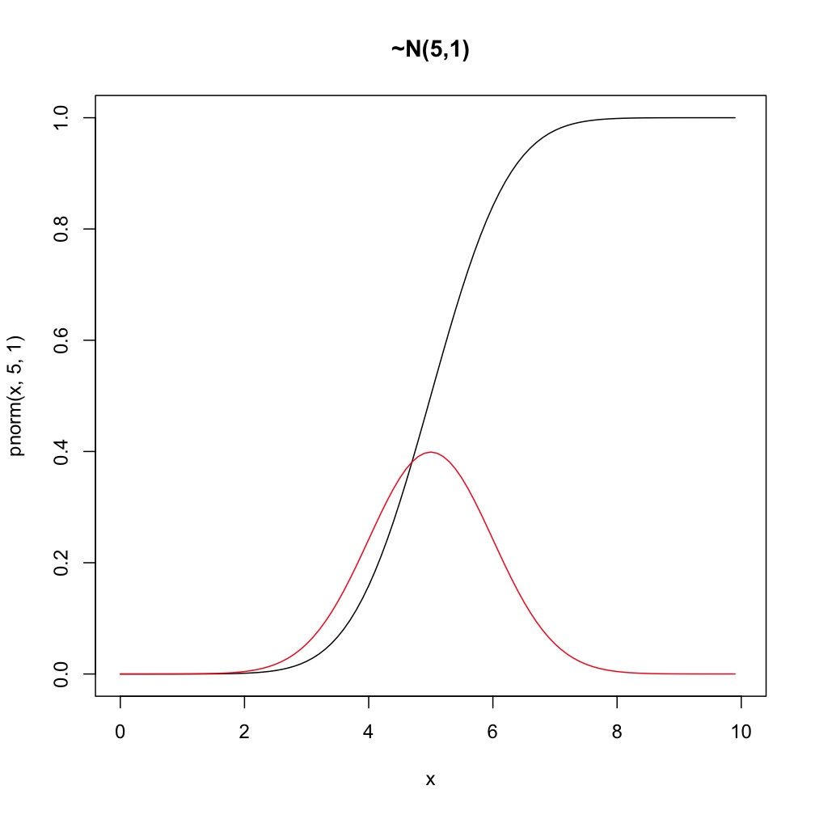
Clarifications on continuous distributions.
AREA UNDER CURVE OF PDF =1
(The integral of the normal)

Slide 26
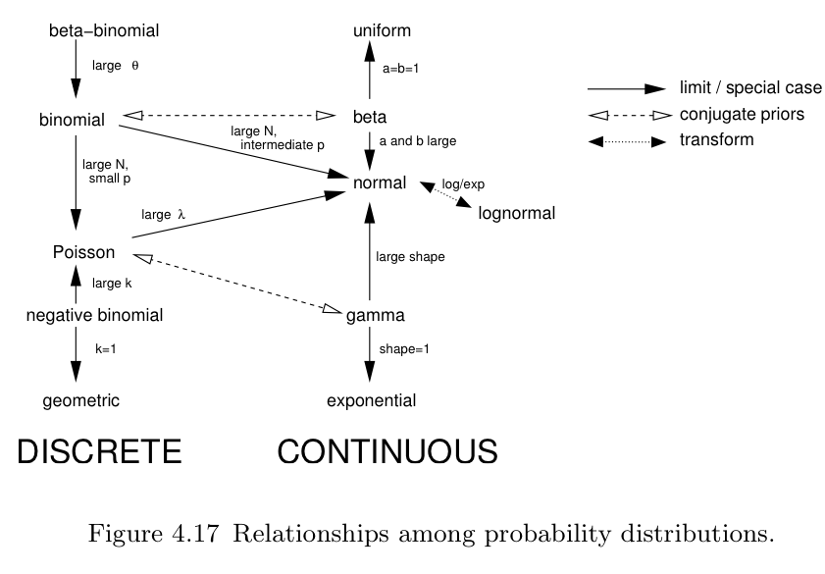
Bolker 2007 CH4 page 137

Slide 27
The multitude of probability distributions allow us to to choose those that match our data or theoretical expectations in terms of shape, location, scale.

Slide 28
Fitting a distribution is an art and science of utmost importance in probability modeling. The idea is you want a distribution to fit your data model “just right” without a fit that is “overfit” (or underfit). Over fitting models is sometimes a problem in modern data mining methods because the models fit can be too specific to a particular data set to be of broader use.
Seefeld 2007

Slide 29
So why do we use them? It’s all about shape and scale!
Because they provide a usable framework for framing our questions, and allowing for parametric methods; i.e likelihood and Bayesian.
Even if we do not know its actual distribution, it is clear frequency data is generally going to be better fit by a binomial than a normal distribution. Why?

Slide 30
Why will it be a better fit?
The binomial is bounded by zero and 1
Other distributions (gamma, poisson, etc) have a lower boundary at zero.
This provides a convenient framework for the relationship between means and variance as one approaches the boundary condition.

Slide 31
Some discrete distributions (leading up to why we may want to use the negative binomial)
Binomial
Poisson
Negative-binomial

Slide 32
Random variables
This is what we want to know the probability distribution of.
I.e. P(x|some distribution)
I will use “x” to be the random variable in each case.

Slide 33
Binomial
Let’s say you set up a series of enclosures. Within each enclosure you place 25 flies, and a pre-determined set of predators.
You want to know what the distribution (across enclosures) of flies getting eaten is, based on a pre-determined probability of success for a given predator species.
You can set this up as a binomial problem.
N ( R calls this size) = 25 (the total # of individuals or “trials” for predation) in the enclosure
p = probability of a successful predation “trial” (the coin toss)
x = # trials of successful predation. This is what we usually want for the probability distribution.

Slide 34
Binomial
You can think of this in two ways.
A) A normalizing constant so that probabilities sum to 1.
B) # of different combinations to allow for x “successful” predation events out of N total.
You will often see x=k and hear “ N choose k”

Slide 35
Example
If predator species 1 had a per “trial” probability of successfully eating a prey item of 0.2, what would be the probability of exactly 10 flies (out of the 25) being eaten in a single enclosure.
P(x=10| bi(N=25,p=0.2)) = 0.0118
Not so high. We can look at the expected probability distribution for different values of x.

Slide 36
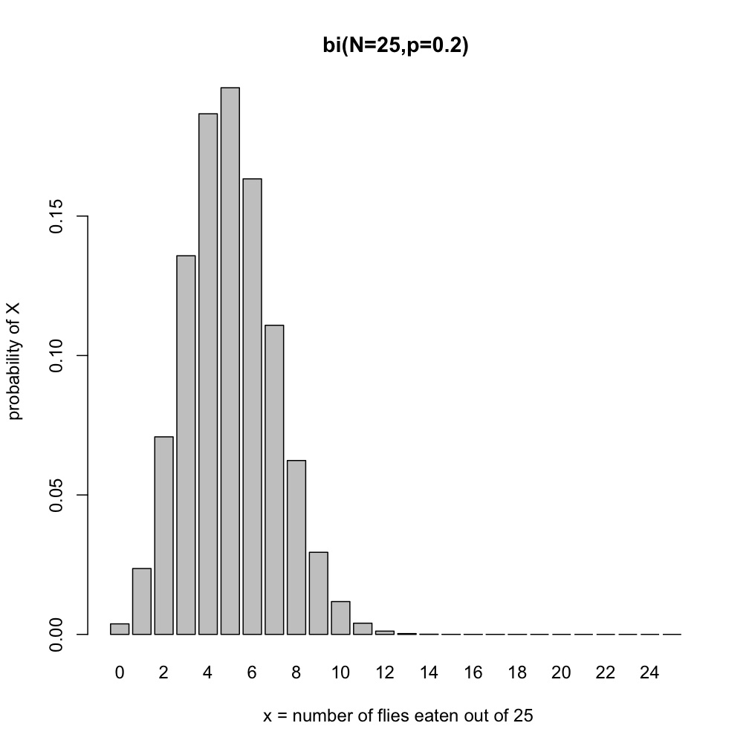
This would be the expected distribution if we set up many replicate enclosures with 25 flies and this predator.

Slide 37
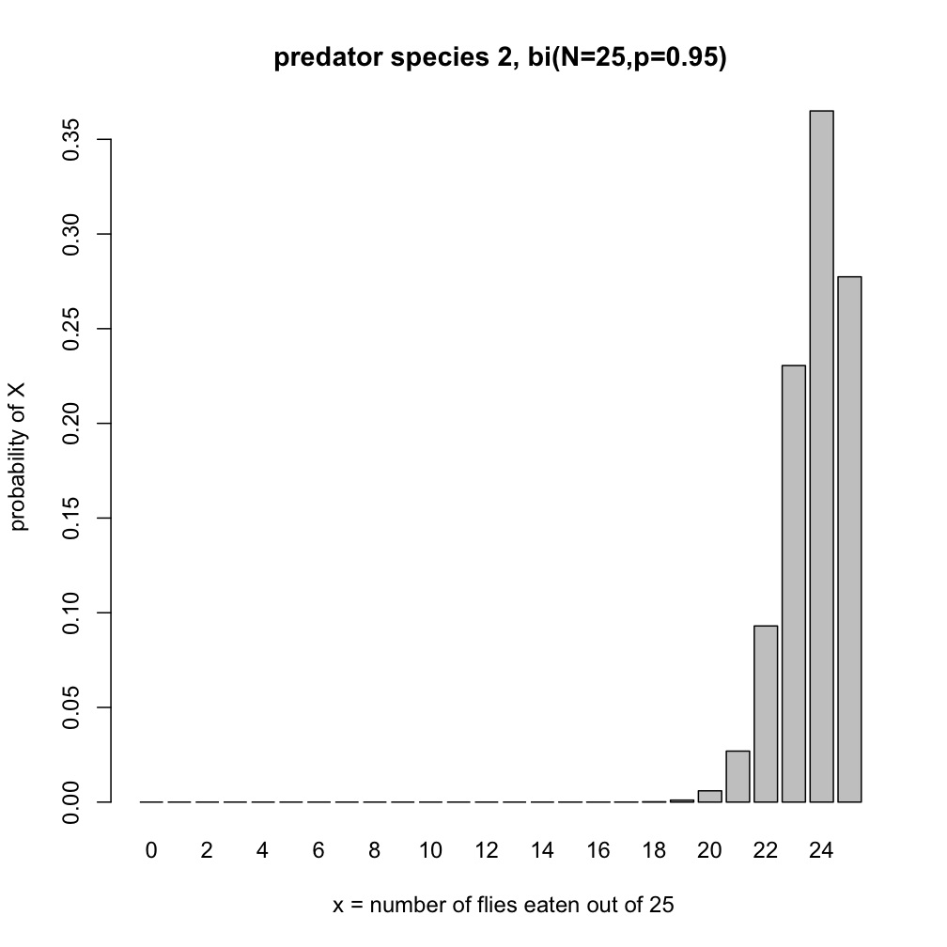
Predator species 2 is much hungrier….

Slide 38
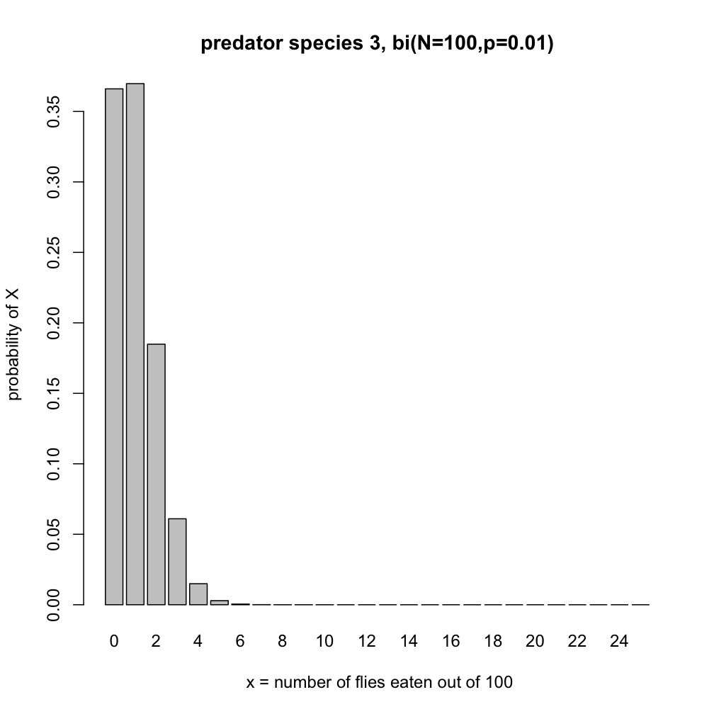
Let’s say we had 100 flies per enclosure, and predator species 3 was really ineffective, p=0.01
While there may be a theoretical limit to the number of flies that can be eaten, practically speaking it is unlimited since the predation probability is so low.
This is a lot like the situation we have with RNA-seq data.

Slide 39
Poisson
When you have a discrete random variable where the probability of a “successful” trial is very small, but the theoretical (or practical) range is effectively infinite, you can use a poisson distribution.
Useful for counting # of “rare” events, like new migrants to a population/year.
# of new mutations/offspring..
# counts of sequencing reads (well sort of)…

Slide 40
Poisson
It is also (potentially) useful for RNA-seq data! (although we will see not very useful).

Slide 41
Poisson
x is our random variable (# events/unit sampling effort) – read counts for a gene in a sample
Is the “rate” parameter. i.e. Expected number of reads (for a transcript) per sample
is the mean and the variance!!!!
For its relation to a binomial when N is large and p is small
λ= N*p

Slide 42
Poisson
Let’s say flies disperse to colonize a new patch at a very low rate ( previous estimates suggest we will observe one fly for every two new patches we examine, λ=0.5).
What is the probability of observing 2 flies on a new patch of land?
P(x=2| poisson(λ=0.5)) = 0.076

Slide 43
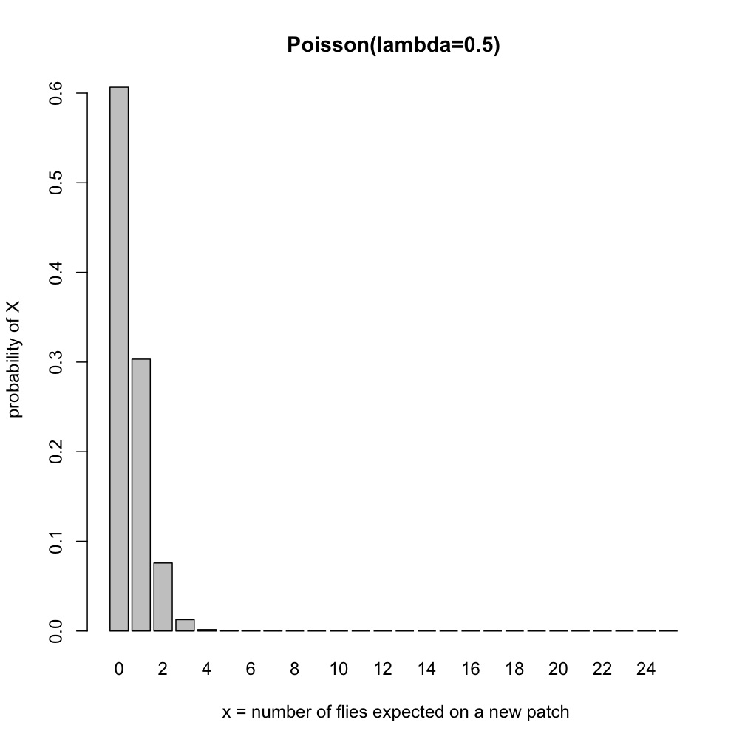
Probability of observing x number of flies on a patch given lambda=0.5

Slide 44
What happens as lambda increases?

Slide 45
Poisson mean and variance
When lambda is small for your random variable, you will often find that your data is “over-dispersed”.
That is there is more variation that expected under Poisson (lambda).
Similarly when lambda gets large, you will often find that there is less variation than expected under Poisson(lambda).

Slide 46
Anders and Huber 2010 Genome Biology

Slide 47
Why poisson might not model sequence reads well
Most RNA-seq data (and most count data in biology) is not modeled well by poisson because the relationships between means and variances tend to be far more complicated among (and within) biological replicates.
It has been argued (Mortzavi et al 2008) that technical variation in RNA-seq is captured by Poisson. I have my doubts even on this.

Slide 48
Quasi-poisson
Since over-dispersion is such a common issue, a number of approaches have been developed to account for it with count data.
One is to use a quasi-poisson.
Instead of variance(x) = λ, it is
Variance (x) =λθ
Where θ is the (multiplicative) over-dispersion parameter.

Slide 49
How about a normal distribution?
Despite working with discrete count data, several authors use normal distributions. Several reasons.

Slide 50
How about a normal distribution?
Despite working with discrete count data, several authors use normal distributions. Several reasons:
When the mean number of counts is far enough away from zero, often the normal distribution does a good job of fitting the data (and capturing mean & variance relationship). For low mean counts a variance stabilization can aid modeling (the approach in limma/voom).
Our response variable (counts of features) are not measured without error, and therefore are not true measures. When estimating effects in our model we account for this uncertainty and assuming a normal distribution enables additional flexibility.

Slide 51
How about a normal distribution?
Despite working with discrete count data, several authors use normal distributions. Several reasons:
When the mean number of counts is far enough away from zero, often the normal distribution does a good job of fitting the data (and capturing mean & variance relationship). For low mean counts a variance stabilization can aid modeling (the approach in limma/voom).
Our response variable (counts of features) are not measured without error, and therefore are not true measures. When estimating effects in our model we account for this uncertainty and assuming a normal distribution enables additional flexibility.

Slide 52
Quasi-poisson
Since over-dispersion is such a common issue, a number of approaches have been developed to account for it with count data.
One is to use a quasi-poisson.
Instead of variance(x) = λ, it is
Variance (x) =λθ
Where θ is the (multiplicative) over-dispersion parameter.

Slide 53
Negative binomial
In biology the Neg. Binomial is mostly used like a poisson, but when you need more dispersion of x (it needs to be spread out more).
The negative binomial is a Poisson distribution where lambda itself varies according to a Gamma distribution.

Slide 54
Negative binomial
Expected number of counts =μ
Over-dispersion parameter = k
For our purposes all we care about is that

Slide 55
General(ized) linear models
For response variables that are continuous, you are likely familiar with approaches that come from the general linear model.
A standard linear regression (if x is continuous).
If x is discrete this would be a t-test/Anova.

Slide 56
Continuity of Statistical Approaches
Process Models
Mixed Effects Model
(random or both)
Predictors:
Fixed
General Linear
Model
Generalized Linear
Model (non-normal)
Response:
(normal)
ANOVA
Regression
(continuous)
ANCOVA
(both)
Predictors:
(discrete)
Number of
Levels:
t-test

Slide 57
Generalized linear models
But what do you do when your response variable is not normally distributed?
The framework of the linear model can be extended to account for different distributions fairly easily (one major class of these is the generalized linear models).

Slide 58
Continuity of Statistical Approaches
Process Models
Mixed Effects Model
(random or both)
Predictors:
Fixed
General Linear
Model
Generalized Linear
Model (non-normal)
Response:
(normal)
ANOVA
Regression
(continuous)
ANCOVA
(both)
Predictors:
(discrete)
Number of
Levels:
t-test

Slide 59
Generalized Linear Models (GLiM)
In many cases a general linear model is not appropriate because values are bounded
e.g. counts > 0, proportions between 0 and 1
A generalization of linear models to include any distribution of errors from the exponential family of distributions
Normal, Poisson, binomial, multinomial, exponential, gamma, NOT negative binomial
General Linear Model is just a special case of GLiM in which the errors are normally distributed
Example, logistic regression
We will use likelihood for parameter estimation and inference

Slide 60
Generalizations of GLM
Instead of a simple linear model:
Y = b₀ + b₁x₁+ b₂x₂ + e
Assume that e’s are independent, normally distributed with mean 0 and constant variance s²
Can solve for b’s by minimizing squared e’s
GLiM considers some adjustment to the data to linearize Y - a link function
Y = g( b₀ + b₁x₁+ b₂x₂ + e)
or f(Y) = b₀ + b₁x₁+ b₂x₂ + e
For example for count data which are always positive
f(Y) = log(Y) log link

Slide 61
What is a link function?
The link function is a way of transforming the observed response variable (LHS).
Goals
1) linearize observed response
2) Alter the boundary conditions of the data.
3) To allow for an additive model in the covariates (RHS)

Slide 62
Poisson Family
Data are counts of something (i.e. 0, 1, 2, 3, 4…)
Number of occurrences of an event over a fixed period of time or space
Examples…
If the mean value is high then counts can be log-normal or normally distributed
When mean value is low then there starts to be lots of zeros and variance depends on the mean
If upper end is also bounded then binomial would be better
Default link is the log link, variance function = μ
i.e., family = poisson (link = “log”, variance = “mu”)
Other option might be the sqrt link

Slide 63
Poisson Family
Frequency Tables (log-linear or multinomial models)
Comparison of counts among categories or cells
Like a G-test (or χ² test)

Slide 64
Poisson and nb Family
Essentially it means you can log transform the sequence counts and use a poisson, quasi-poisson or negative binomial to fit it
(most links are more complicated, this is nice and simple).
i.e. counts are modeled as

Slide 65
Methods using nb glm
edgeR (but it is not default, so beware!)
DESeq/DESeq2 (maybe DEXseq as well?)
BaySeq
Limma (voom – kind of sort of…).
However these all model the variance quite differently (how they borrow information across genes to estimate mean-variance relationships).
See Yu, Huber & Vitek 2013 (Bioinformatics) for discussion of this issue.

Slide 66
Methods using poisson and quasi-poisson
tspm (two stage poisson model)
Fits models with poisson first. If over-dispersed then uses a quasi-poisson.
Thus there are essentially two groups of genes.

Slide 67
Why this is useful
Since we can fit these as a generalized linear model, we can fit arbitrarily complex designs (if we have sufficient sample sizes to estimate all the parameters).
We can incorporate all aspects of read length, library size, lane, flow cell in addition to all of the important biological predictors (your treatments).
NO t-tests for you!!!

Slide 68
Estimating over-dispersion (variance) (or why programs seemingly doing the same thing give different results)

Slide 69
Variances require lots of data to estimate well (not just for count data)
It turns out that to estimate variances, you need a lot more replication than you do for means.
However most RNA-seq experiments still have small numbers of biological replicates.
So how to go about estimating variances?

Slide 70
IF sample sizes are large (within and between treatments).
Most methods do well (based on NB, quasi-P or non-parametric approaches).
They can model individual level variances (and potentially can use resampling approaches to avoid having to make parametric assumptions).

Slide 71
But if sample sizes (in terms of biological replication) is small.
Then we have a problem.
This is where the software really tends to differ, as they all make (different) assumptions about the uncertainty in counts, mean-variance relationships, and how best to model such effects.
In particular edgeR and DEseq use some methods to borrow information across genes (and have options to change this process).
This can dramatically change the results.
Anders, S., & Huber, W. (2010). Differential expression analysis for sequence count data. Genome Biology, 11(10), R106. doi:10.1186/gb-2010-11-10-r106
Anders et al (2013). Count-based differential expression analysis of RNA sequencing data using R and Bioconductor. Nature Protocols, 8(9), 1765–1786

Slide 72
Yu et al (2013). Shrinkage estimation of dispersion in Negative Binomial models for RNA-seq experiments with small sample size. Bioinformatics, 29(10), 1275–1282.

Slide 73
Anders and Huber 2010

Slide 74
Let’s think about this.
Love, Huber & Anders 2014 BioRXiV doi: 10.1101/002832

Slide 75
We can also “shrink” estimates based on over-dispersion….

Slide 76
Take home
With small sample sizes, the methods use different approaches to get gene-wise over-dispersion (based on all data).
EdgeR is more powerful (more significant hits) than DGE generally. But much more susceptible to false positives due to outliers.
DGE2 “should” be somewhere in the middle.

Slide 78
Biological replication gives far more statistical power than increased sequencing depth within a biological sample!!!!
Sequencing (and library prep) costs are still sufficiently expensive that most experiments use small numbers of biological replicates.
Given the additional costs of library costs (~225$/sample at our facility), many folks go for increased depth instead of more samples.
For a given level of sequencing depth (total) for a treatment, it is far better to go for more biological replicates, each at lower sequencing depth (rather than fewer replicated at higher sequencing depth).

Slide 79
Biological replication gives far more statistical power than increased sequencing depth within a biological sample!!!!
Robles et al. 2012

Slide 80
How do the methods compare in simulation?
Kvam et al. 2012

Slide 81
How do the methods compare in simulation?
Kvam et al. 2012

Slide 82
How do the methods compare for real data?
Kvam et al. 2012

Slide 83
How do the methods compare in a different set of simulations?
Will explain
ROC (receiver operator curves) and the area under curves on board.
Soneson 2012

Slide 84
Differential expression (subset, see my github page)
DEseq (http://www.ncbi.nlm.nih.gov/pubmed/20979621)
DeSeq2
Limma/voom
EDGE-R
Sailfish (kmer approach)
EBseq (RSEM/EBseq)
Beers simulation pipeline(http://www.cbil.upenn.edu/BEERS/)
DEXseq (http://bioconductor.org/packages/release/bioc/html/DEXSeq.html)

Slide 85
References
Robles, J. A., Qureshi, S. E., Stephen, S. J., Wilson, S. R., Burden, C. J., & Taylor, J. M. (2012). Efficient experimental design and analysis strategies for the detection of differential expression using RNA-Sequencing. BMC Genomics, 13, 484. doi:10.1186/1471-2164-13-484
Bullard, J. H., Purdom, E., Hansen, K. D., & Dudoit, S. (2010). Evaluation of statistical methods for normalization and differential expression in mRNA-Seq experiments. BMC Bioinformatics, 11, 94. doi:10.1186/1471-2105-11-94
Kvam, V. M., Liu, P., & Si, Y. (2012). A comparison of statistical methods for detecting differentially expressed genes from RNA-seq data. American Journal Of Botany, 99(2), 248–256. doi:10.3732/ajb.1100340
Soneson, C., & Delorenzi, M. (2013). A comparison of methods for differential expression analysis of RNA-seq data. BMC Bioinformatics, 14, 91. doi:10.1186/1471-2105-14-91
Wagner, G. P., Kin, K., & Lynch, V. J. (2012). Measurement of mRNA abundance using RNA-seq data: RPKM measure is inconsistent among samples. Theory in biosciences = Theorie in den Biowissenschaften, 131(4), 281–285. doi:10.1007/s12064-012-0162-3
Vijay, N., Poelstra, J. W., Künstner, A., & Wolf, J. B. W. (2012). Challenges and strategies in transcriptome assembly and differential gene expression quantification. A comprehensive in silico assessment of RNA-seq experiments. Molecular Ecology. doi:10.1111/mec.12014

